Slide 1
Opposition template
About group: B by: Fabian Kagel

Slide 2
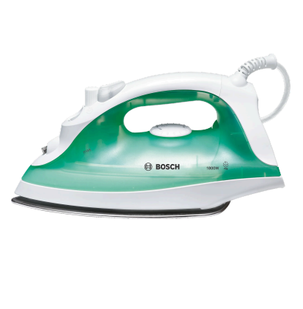
Product
What product was it? Household steam iron
Bosch TDA2315

Slide 3
Opposition report template for evaluation
Professional Layout: Text, visuals, tables, and calculations are clear and easy to follow.
This opposition template provides structured feedback. Replace the text below or add slides as needed for a thorough evaluation.
Key strengths
Coverage of All Required Areas: The report successfully addresses all mandated domains: BOM, function analysis, sequencing, DFA, line balancing, workstation and layout design, and economic analysis.
Detailed Process Analysis: The PFMEA is notably thorough, identifying root causes and RPNs for 29 operations. This shows strong process understanding and risk-awareness.
Sophisticated Line Balancing Work: All relevant methods (LCR, RPW, Kilbridge) were applied and compared. The custom method stands out for its practical focus and efficiency.
Integration of Lean and Ergonomics: The layout and workstation sections were well-reasoned, demonstrating lean principles (FIFO, buffer zones, ergonomic workbenches, sensor-based refill logic).
CAD & Visuals: CAD exploded views, station diagrams, and flow layouts are high quality
Workstation Design with Tool Assignment: Tool distribution per station was clearly described, showing solid attention to production feasibility.
Areas for improvement
Unclear Functional Mapping: While functions of the iron are described, there's no formal function mapping (e.g., function structure or FAST diagram), which was expected from the scope.
Weak DFA-Based Redesign: The redesign section is superficial. There is no concrete proposal to reduce part count, simplify joining, or increase efficiency based on the DFA index
Assumptions Not Robustly Justified: Market demand estimation (Clas Ohlson market share of 27.5%) lacks citation or comparison to benchmarks
No Quantitative Workstation Load Analysis: The custom method is chosen by reasoning alone, without simulation, ergonomic stress metrics, or operator time balancing validation.
Assessment of implementation and results
Well Documented: The workflow from BOM to PFMEA to line layout is documented in a logical, layered fashion.
Completeness: Nearly all core elements were covered; only functional mapping and redesign are underdeveloped.
Scenario Development: Only one production scenario is evaluated. Higher grades would benefit from multi-scenario analysis (e.g., batch vs. mass, automation scale-up).
Report and presentation
Good Structure: The report has a consistent structure and logical progression.
Professional Layout: Text, visuals, tables, and calculations are clear and easy to follow.
Presentation: to be evaluated

Slide 4
Questions for discussion and suggestions
List 2-4 questions to discuss during opposition
Provide constructive recommendations
Can you propose any part reductions or design simplifications based on your DFA results?
Did you consider any corrective actions or design changes to reduce the risk in the more critical operations?
Could you explain how you decided which operations to assign to each station? Were there specific criteria you followed?
Add a function analysis (FAST diagram or function tree) to better link parts to functionality.
Use your DFA and PFMEA findings to suggest a simplified design. Possibly combining plastic housing elements or reducing screws.
Strengthen your market and demand estimation using comparisons or industry data from more than one source.
Propose an alternative low-volume scenario or semi-automation path to demonstrate flexibility.
Include ergonomic or workload analysis to validate your custom balancing solution.
Final verdict
Group B’s project demonstrates a solid application of assembly engineering concepts, supported by rich documentation, strong visuals, and clear process logic. The analysis is practical and well thought out, especially in layout and line balancing. Still, a lack of depth in redesign and overreliance on assumptions in demand planning slightly limit the academic rigor. With more critical validation and scenario breadth, this could easily be a top-tier submission.

