Slide 1
Peer Review on Group E
by: Sujay Maruthish

Slide 2
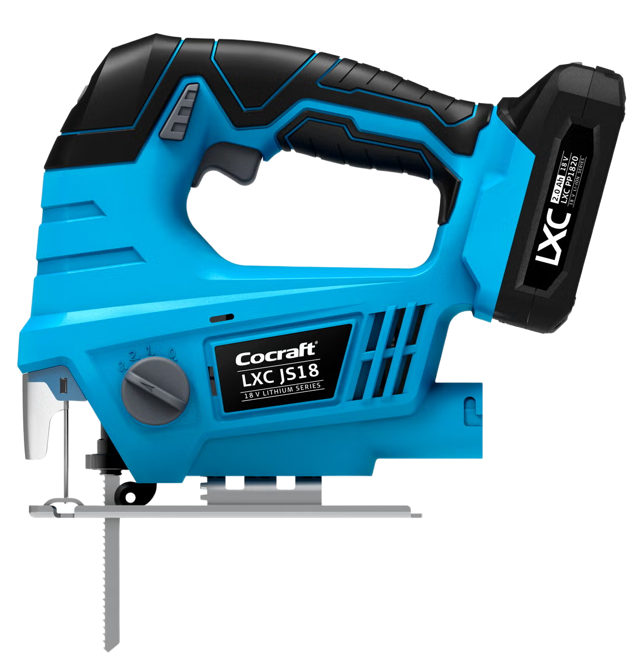
Electric Saw
The Cocraft LXC

Slide 3
Key strengths
The report is well structured as per logical flow of contents.
They have worked on all the major aspects of the project with proper justification.
Workstation design and the think process behind it is executed well.
Identifying the possible product design modifications, which helps to reduce the assembly time.
The cost analysis and comparison of manual, semi-automated and automated by is shown in detail.
The dimension of parts were shown in a unique way.
The overall team co-ordination and effort reflects in their work.

Slide 4
Areas for improvement
The thickness of the part could have been shown.
Liaison Sequence diagram could have helped to understand the part dependencies better.
Comparisons with different methods in line balancing for manual methods, could have given a better overview and why customization is required.
The DFA index calculations could have helped to understand the current efficiency, and the efficiency after design improvements.

Slide 5
Assessment of implementation and results
The assumptions made in few of the calculations, could have used some valid existing references.
The DFA automatic assembly calculations using Eskilander method is missing.
Most of the findings had valid explanation, and the sequence of the information is correct.
Report and presentation
The overall format of the report is well-written, consisting of a clear explanation to the topic.
Few things which can be improved:
The list of figures should be shown after the table of content.
The sub heading font size is smaller than the regular text.
Use an in-text citation like “[1]” and then in your References list include the full entry.

Slide 6
Questions for discussion and suggestions
Question:
Recommendations
Why didn’t you calculate the DFA Index efficiency for manual assembly?
Why didn’t you include the fixed costs in calculations of manual assembly?
The handling and insertion timing should be shown separately.
The exploded view of the exact product provides clear idea, which helps in assembly of the product.
Final verdict:
The report is exceptionally well-written covering all the key aspects which was taught during the course. Though the DFA section and few other parts could be improved in the final draft. I would say the team has done an excellent work in their key findings; they have explained their ideas and thoughts clearly which a reader can understand.

