Slide 1
Opposition Report
About group: E by: Nick Röttgers

Slide 2
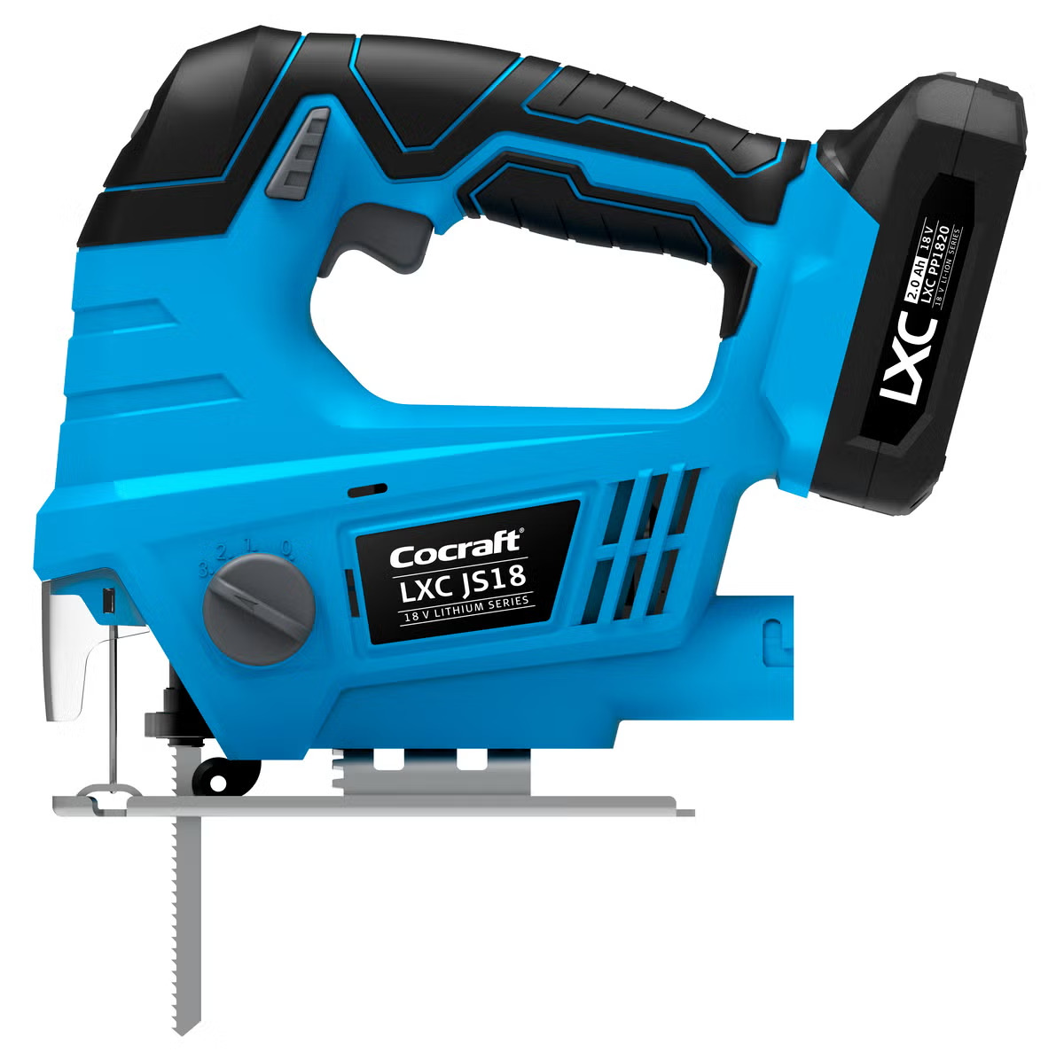
Product
What product was it? Electric Saw

Slide 3
Opposition report template for evaluation
This opposition template provides structured feedback. Replace the text below or add slides as needed for a thorough evaluation.
Key strengths
The group applied all three line balancing methods and compared them. They developed a hybrid solution, which incorporates ergonomic grouping and automation.
The group provided detailed workstation descriptions and visualizations and explained their thoughts well in the text. Use of automation at the stations has been well justified
Challenges like the high process time in Op 33 have been solved well through automation and dividing into sub processes. Also the group included a quality check in their operations. Innovative is also that design improvements have been developed based on own experience which makes their motivations well understandable as a reader
The group justified tool selection in the station design and automation sections with external references and cycle time improvements. The U-shaped layout was also rationalized efficiently
Report structure flows well across sections and the fact that there is no contradictory information indicates strong collaboration and shared responsibility for the different project work areas.
Areas for improvement
Some figures in Chapter 4 lack justification, such as the assumed demand of 100,000 units/year. This assumption could be strengthened by supporting it with market data.
The group mentions grouping based on ergonomics within line balancing but the actual ergonomic assessment lacks specifics and is hard to follow as a reader.
In line balancing section, process 33 has a time of 90 seconds, exceeding the available station time. However, Kilbridge and RPW divide it into three sub-processes, while LCR treats it as two. An explanation for the splitting approach would be helpful.
Chapter 4.e should briefly justify why RPW was chosen. For example based on efficiency, utilization, etc.

Slide 4
Opposition report template for evaluation
Assessment of implementation and results
In the exploded views, the group mentions the model isn't exactly their product. Including a source reference would add clarity and credibility.
The node diagram could be better structured, as the overlapping connections make it difficult to follow the relationships clearly.
In the DFA section, calculating the index would have helped illustrate the product’s assembly efficiency. It would also provide a more reliable basis for your suggested improvements, as you could calculate the index their as well.
Since automation aspects were considered, it could be worth including a DFA for automatic assembly. As this is a draft, the group may already plan to add it.
Report and presentation
The report follows the courses expected format and has a flow. Chapter titles and progression make sense
Chapter 1 contains many technical details before I as a reader could get a good enough picture of it. A brief project background would help provide context and serve as a clearer starting point.
Some figures and tables are included without being referenced in the text. A brief description of their content would improve clarity.
The economic analysis is well done and directly connects to the findings from the previous chapters.

Slide 5
Questions for discussion and suggestions
List 2-4 questions to discuss during opposition
Provide constructive recommendations
You applied multiple line balancing methods and then customized the final solution. What were the key factors that led you to combine RPW with ergonomic grouping?
How did you evaluate the effectiveness of the U-shaped layout for your assembly line compared to alternatives? What advantages did you prioritize?
What advantages did you see in using a fixture that moves with the product through the line, instead of a fixed fixture at each station?
Integrate visuals more clearly into the text
Many figures and tables are useful, but some are inserted without explanation. Briefly introducing each visual in the text and summarizing what it shows would improve clarity and help the reader follow your logic.
Basic ergonomic reasoning to workstation design
Your ergonomic grouping is a great idea. To strengthen it, consider referencing basic ergonomic principles to support your grouping choices and workstation layout.
Structure economic comparisons more transparently
The economic section presents meaningful content. In the final version, consider adding a clearer breakdown comparing manual vs. automated time, cost per unit, or return on investment to support your conclusions.
Final verdict (provide a final comment summarising your overall impression of the project report).
The report shows a good overall understanding of the assembly process, with well thought-out solutions like the station design and automation choices. It is a solid draft with solid technical depth, and with some clearer explanations and visual integration, it is on track to becoming a good final report.

