Slide 1
Opposition template
About group: [E] by: Bhargav Tantri

Slide 2
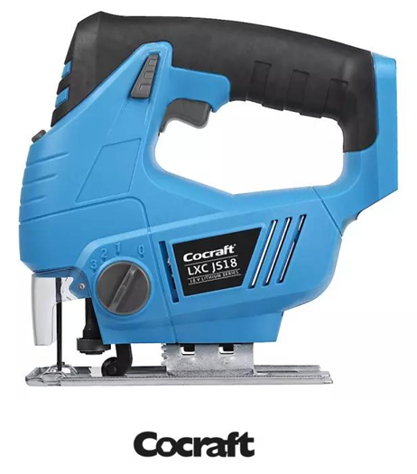
Product
Electric Saw

Slide 3
Opposition report for evaluation
Key strengths
Clear visual representation of the node diagram
Inclusion of practical quality checks in the final steps
Thoughtfully designed assembly line and workstation layout
Detailed economic analysis comparing manual vs. semi-automatic setups
Areas for improvement
Exploded view is messy and hard to interpret
Precedence diagram is unclear
Assembly times lack mention of averaging across multiple trials
Motivation for assuming the product demand
Line balancing comparison would benefit from a histogram
Assessment of implementation and results
Manufacturing process is well documented and realistic
DFA improvements are practical
Results and line balancing are valid
Report and presentation
Report is logically structured and easy to navigate

Slide 4
Questions for discussion and suggestions
List 2-4 questions to discuss during opposition
Provide constructive recommendations
What market research supports the annual demand assumption?
Have you considered fully automating the entire production line? What would be the main barriers or trade-offs?
Visual tools like histograms for better comparison
Use averaged assembly time trials for realistic estimates
Include a liaison sequence diagram to better visualize part interactions and assembly flow
Final verdict
A good project with clear organization and good technical skills. The team made good use of industrial engineering including careful economic modeling and realistic assembly guidelines. Refining some visual and methodological elements would elevate the work.

