Slide 1
Opposition Report
About group: F by: Jegan Joseph Philip Joseph Beschi

Slide 2
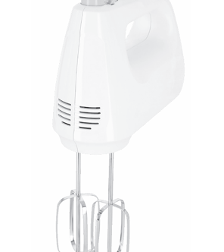
Product
What product was it?
The product was Hand Mixer

Slide 3
Key Strengths
Group F project covers all the major topics and requirements of the project, and it is well structured. The product description, precedence and LSD, DFA analysis are done with correct procedure.
All major assembly analysis mentioned during the lecture activities are used, tools like Boothroyd DFA, Eskilander for automation DFA and line balancing methods LCR, Killbridge, RPW etc.
The design improvements are very specific not vague, by analyzing symmetry and geometric changes for better assembly process.
The reasoning for choosing manual over automated assembly is well explained that justifies by production volume, cost and complexity.

Slide 4
Areas for Improvement
The Liason diagram does not convey the its primary requirement. It doesn’t show how the parts are connected for e.g. is it by screw fit or latch in.
The team has mentioned automation assembly only briefly, more discussion on what changes would make automation feasible is not discussed.

Slide 5
Assessment of implementation and results
The project almost covers all the requirements of the project like BOM, part functions, DFA and line balancing methods.
Report
The Report is well structured and neatly presented. The clarity of tables and images help us to understand the project.

Slide 6
Questions for discussion and suggestions
Questions?
Provide constructive recommendations
What changes in product design can make is feasible for automation assembly?
What is the most problematic feature in the product that stops you from using automated assembly?
Improve the Liason diagram.
Discuss more about justification of assembly sequence.
Final verdict
Overall, the project is well structured and well executed by following the project requirements. The improvements can be done in some places to reach a better standard. More scenarios and justification of key assumptions can be implemented. Good work group F

